Slide 1
Exploration Value Drivers and Methodologies
January 2020

Slide 2
Our Company
We are a private owned exploration company with active exploration in the north of Chile, we also give advise to our partners on the identification of exploration targets and mining projects opportunities in Chile, Peru and Argentina.
We provide an independent, senior level mine evaluations of mineral properties and give support on due diligence and resource estimation at all stages of the mine project life from discovery, acquisition, and to potential production development.

Slide 3
Our Team
Eduardo Zamanillo Villegas, MBA
Mine Engineer, Partner
Business Development Professional with 20 years of experience working for International companies, with a Mining Engineering degree and an MBA in UK. With business experience in the mining, energy and investment industries, working for multinational companies such as Exxon/AngloAmerican, BHP and Mitsui & Co. among others. Management of investment projects from conception to commercial operation, leading multidisciplinary teams for the acquisition and integration of companies in South America.
Felipe Contreras Alvarez, MBA
Bachelor of Commerce, Partner
Economist with 15 years of experience working in Corporate Investment Banking. Pablo previously worked for BNP Paribas where he spent seven years supporting clients across the global metals and mining sector. He advised on a number of M&A and capital markets transactions as well as corporate development initiatives for companies in base metals sector.

Slide 4
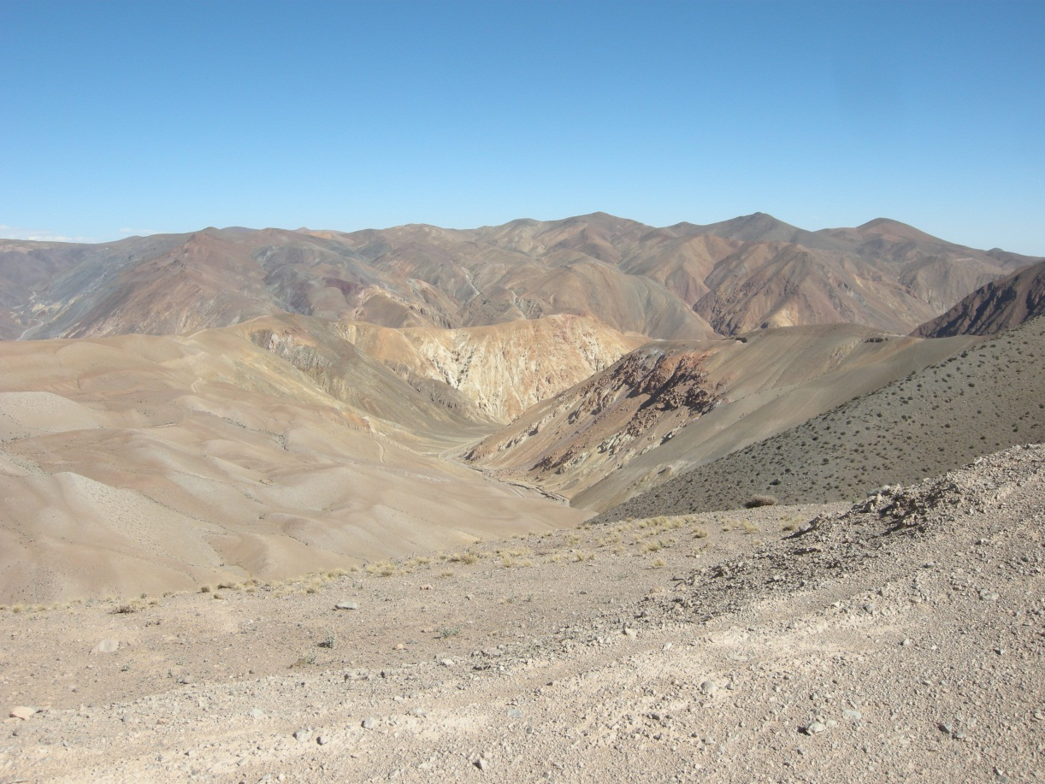
Exploration Value Drivers and
Methodologies
J.A.Bell and P.Guj

Slide 5
Exploration Value Drivers and Methodologies
The valuation of a mineral exploration project is an imperfect process, in part due to inadequate information on numerous value drivers, but also to the common ad-hoc application of overly simplistic valuation methodologies.
When dealing with early-stage exploration projects the valuation methodologies used are inevitably reliant upon subjective opinion.
Such methods generally rely upon previous or anticipated future expenditure (the cost-based approach) and a comparison with the sales prices of projects with similar characteristics (the market-based approach).
Notes:
To lessen the shortcomings of each method, valuers adjust the impact of real world value drivers by ad-hoc market or ‘industry experience’ factors. The use of these experienced based adjustments is peculiar in that the independent experts (usually large accountancy based institutions) who appoint specialist mineral asset valuers are prohibited from using such unquantifi ed adjustments

Slide 6
KEY VALUE DRIVERS
The value of an exploration project is influenced by a myriad of factors, each of which has a potentially different impact under different timings and circumstances. Obviously, the principal value driver is the potential of a project to yield positive cash flows from possible future mining activities.
However, projects at the early stages of mineral exploration do not lend themselves to cash flow or probability based modelling as almost every deposit is unique in its location, formation, detectability and economics. As a consequence, the key value drivers of an exploration project may need to include other factors such as its location, size, target characteristics, commodity price and current market (ie demand and supply) for similar projects).

Slide 7
Geological location
A valuer must be cognisant of whether a project is located in a fertile mineral belt, if so whether it is located in a site of known deposit clusters and finally, if the belt is still immature enough to yield significant discoveries.
Target value
Bigger target → lower probability to find
If large tenement areas are held in a single project, then there is increased likelihood of covering a mineral camp or of discoveries with desirable value profiles.
Area
Project market
While it is always desirable to have a large project area, in mature mining jurisdictions large tenements are likely to have high holding costs in the form of government mandated rent, rates and expenditure commitments.
Commodity, financial and security markets
such drivers affect the speculative aspect of the exploration market, with competition for a project increasing as the markets become more speculative.

Slide 8
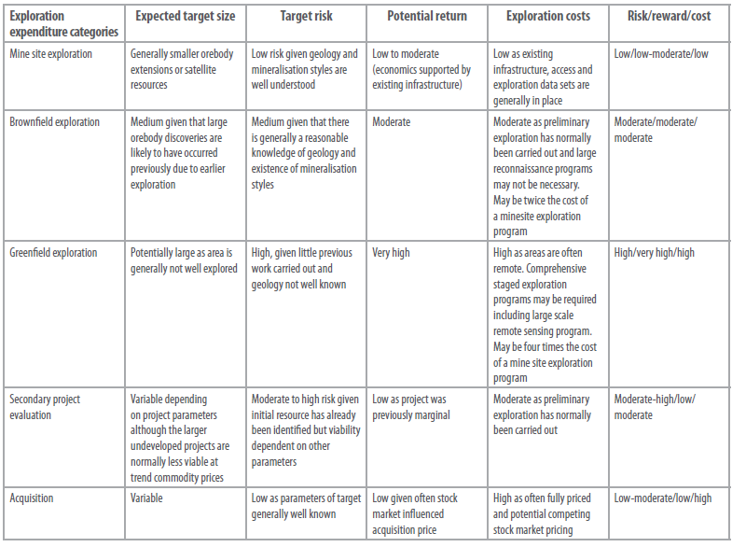

Slide 9
COMMON VALUATION METHODS
rules-of-thumb or mental shortcuts which enable pattern recognition
Heuristic errors
• Representivity – there is a tendency to over-generalise based on limited, imperfect data sets containing only a few data points. Consequently, data density and quality may have big impacts on the realism of interpretations.
• Availability – the outcomes are usually based upon personal experience, often resulting in the full range of possibilities not being adequately considered or even being truncated.
• Anchoring – initial impressions anchor subsequent perceptions and thus influence outcomes. Any adjustments to the initial impression are often insufficient, narrow and biased towards the anchor.
• Salience – the most recent and prominent information overly influences judgement and there

Slide 10
COMMON VALUATION METHODS
The hedonic (‘market-based’) approach uses transaction prices of project sales in similar geographical, geopolitical and geological environments to derive a market value using
a process similar to that used by the real estate industry
Market-based approach
The comparable market value approach is an adaptation of the common real estate method of valuation. For the purpose of mineral asset valuation, a valuer compiles and analyses
100 per cent equity acquisitions of projects of similar nature, time and circumstance with a view to establishing a range of values that the market is likely to pay for a project.
Comparable transactions method

Slide 12
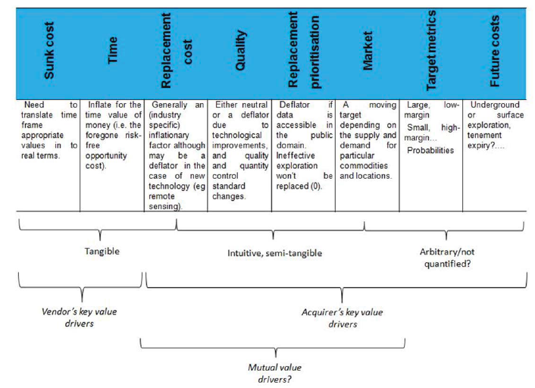

Slide 13
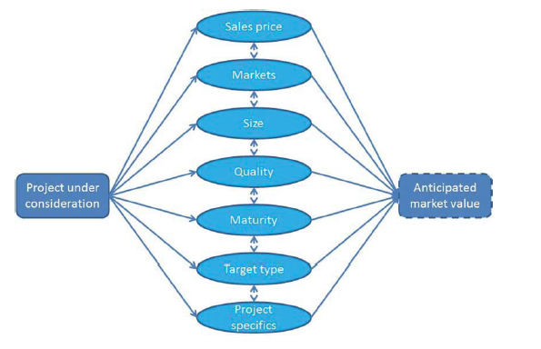
A basic neural-network example

Slide 14
Exploration is a high risk, uncertain process. The underlying
value drivers are interconnected and their relationship may be non-linear. The uncertain value drives include size, target qualities, exploration models, project maturity and the supply and demand for exploration projects. The complexity of these value drivers has resulted in the widespread use of heuristic or rule-of-thumb valuation methods.

